Slide 1
From Tutte to Floater and Gotsman: On the Resolution of Planar Straight-line Drawings and Morphs
Giuseppe Di Battista and Fabrizio Frati
GD 2021

Slide 2
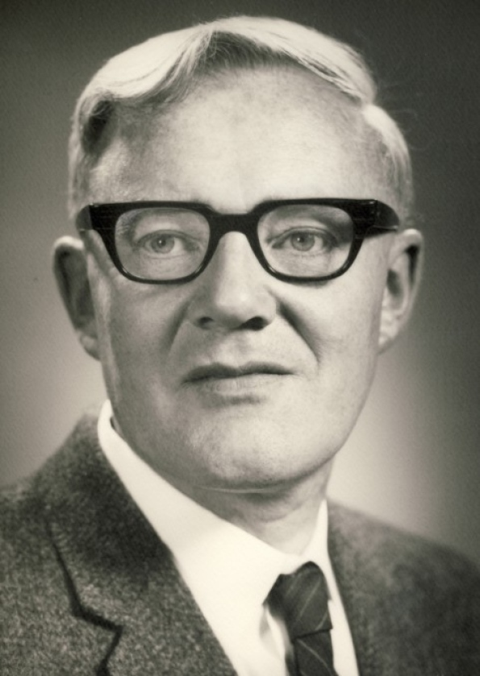
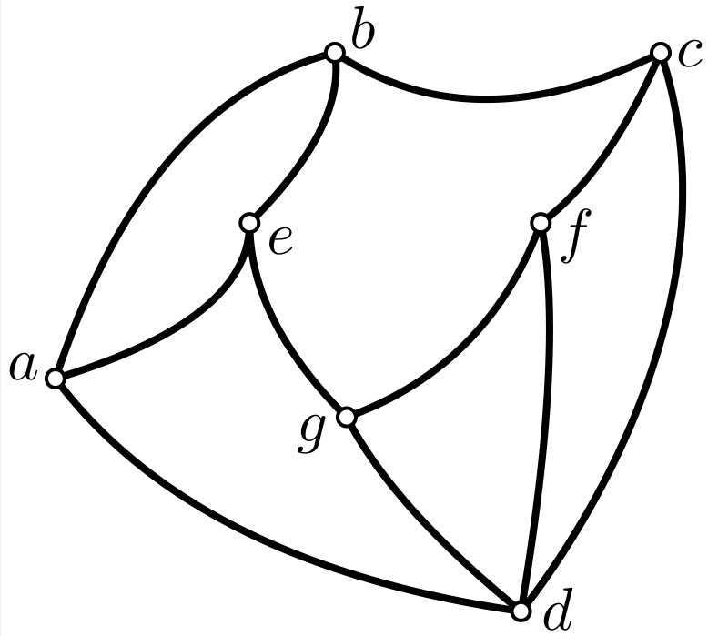
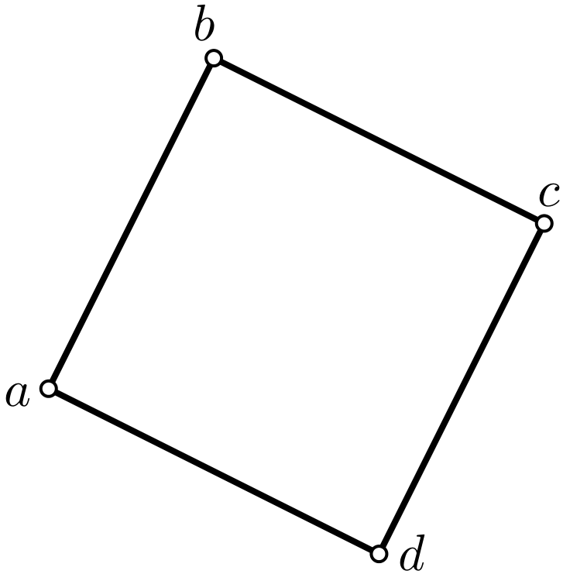
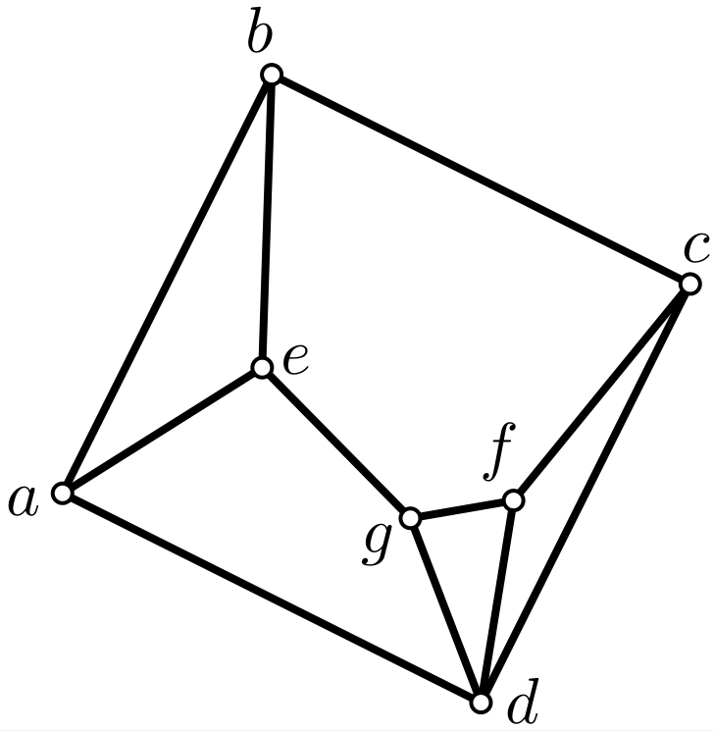
Tutte’s embedding algorithm
Given a $3$-connected plane graph $G$ and a convex polygon $𝒫$ representing the boundary of the outer face of $G$…
the straight-line drawing of $G$in which each internal vertex is at the barycenter of its neighbors is planar and convex.

Slide 3
Tutte’s embedding algorithm
For each internal vertex $v$ of $G$ with neighborhood $𝒩\left(v\right)$ and degree $δ\left(v\right)=|𝒩\left(v\right)|$
$x\left(v\right)=\sum_{u∈𝒩\left(v\right)}{\left(\frac{1}{δ\left(v\right)}∙x\left(u\right)\right)}$
$y\left(v\right)=\sum_{u∈𝒩\left(v\right)}{\left(\frac{1}{δ\left(v\right)}∙y\left(u\right)\right)}$
Spurred the research on force-directed methods

Slide 4
Floater’s embedding algorithm
For each internal vertex $v$ of $G$ and any vertex $u∈𝒩\left(v\right)$, let $λ_{vu}$ be any positive coefficient such that $\sum_{u∈𝒩\left(v\right)}{λ_{vu}}=1$. Then the system
$x\left(v\right)=\sum_{u∈𝒩\left(v\right)}{(λ_{vu}∙x\left(u\right)) }$
$y\left(v\right)=\sum_{u∈𝒩\left(v\right)}{(λ_{vu}∙y\left(u\right))}$
admits a unique solution, which corresponds to a convex straight-line drawing of $G$.

Slide 5
Floater’s embedding algorithm
Used for surface parameterization and reconstruction in computer graphics, in multiresolution problems, …
Definition: Tutte drawings and Floater drawings!
Theorem F: Every convex planar straight-line drawing of a $3$-connected plane graph is a Floater drawing, for suitable coefficients $λ_{vu}$.

Slide 6
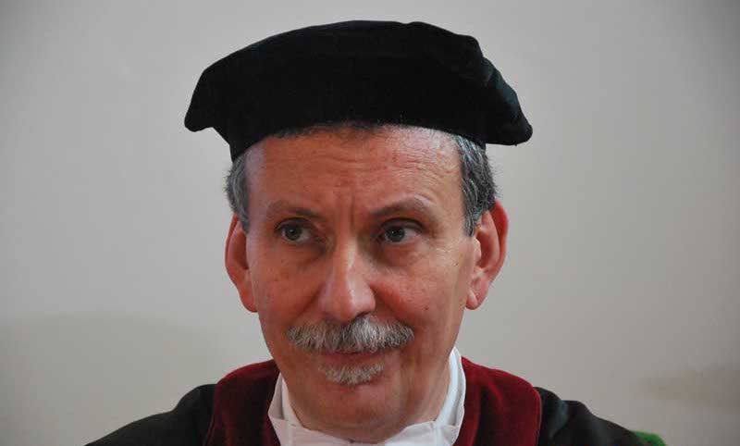
The questions we study
How good/bad is the resolution of Tutte and Floater drawings?
Definition: The resolution of a planar straight-line drawing is the ratio between the minimum and maximum Euclidean distances between two ʽʽseparatedʼʼ geometric objects:
Two distinct vertices
Two non-adjacent edges
A vertex and a non-incident edge

Slide 7
State of the art
For every large $n$, there exists an $n$-vertex plane graph whose Tutte drawing has resolution smaller than or equal to $\frac{1}{b^{n}}$, for some constant $b>1$ [Eades and Garvan, GD 2005] [Chambers, Eppstein, Goodrich, and Lӧffler, JGAA 2012]
Is the resolution of Tutte and Floater drawings finite (can it be expressed as a function of natural parameters)?

Slide 8
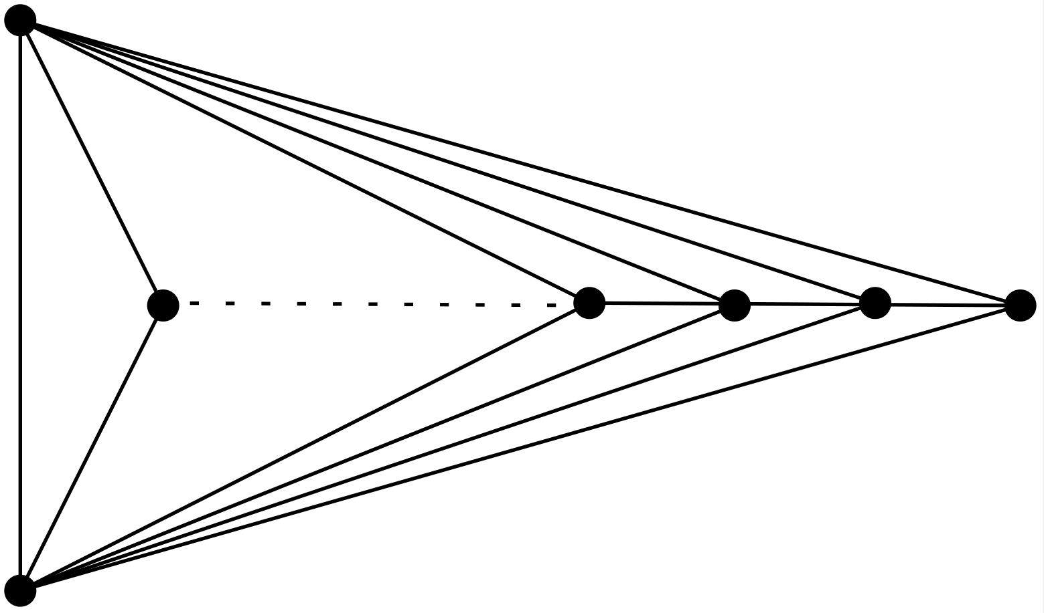
Theorem 1: The resolution of a Floater drawing $Γ$of an $n$-vertex maximal plane graph is larger than or equal to $r_{Δ}∙λ^{O(n)}$, where:
$r_{Δ}$ is the resolution of the triangle $Δ$ bounding the outer face of $Γ$
$λ$ is the smallest coefficient $λ_{vu}$, over all pairs of neighbors $(v,u)$.
The bound $r_{Δ}∙λ^{O(n)}$ is tight!
(for the class of graphs presented by [Eades and Garvan, GD 2005] )

Slide 9
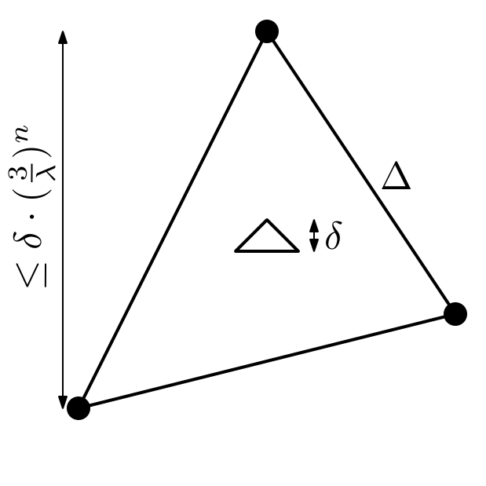
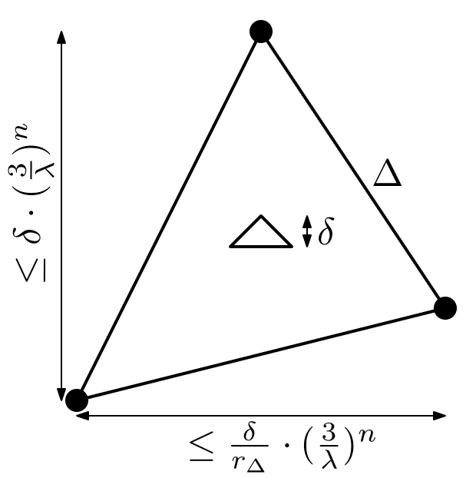
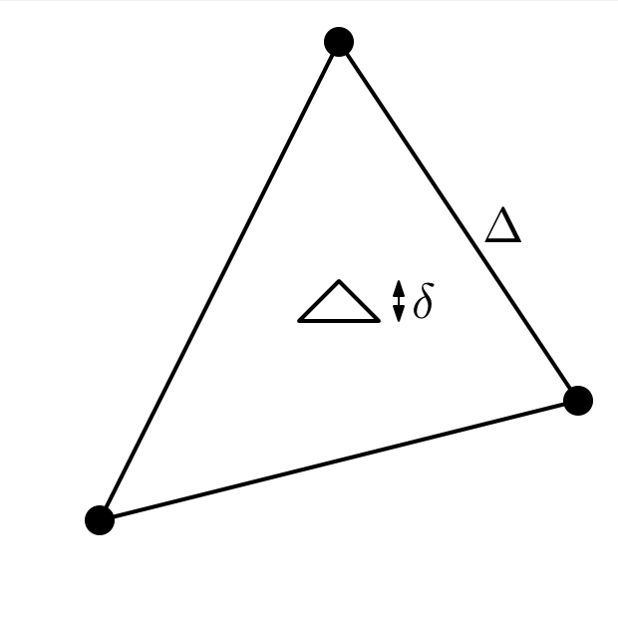
A geometric and topological proof!
Let $δ$ be the smallest distance between two geometric separated objects in $Γ$.
The $y$-extent of $Γ$ is at most $δ∙{\left(\frac{3}{λ}\right)}^{n}$.
The $y$-extent of $Γ$ is at most $δ∙{\left(\frac{3}{λ}\right)}^{n}$.
The $x$-extent of $Γ$ is at most $\frac{δ}{r_{Δ}}∙{\left(\frac{3}{λ}\right)}^{n}$.
→ The largest distance between two geometric separated objects in $Γ$is in $\frac{2δ}{r_{Δ}}∙{\left(\frac{3}{λ}\right)}^{n}$.
→ The resolution of $Γ$ is larger than or equal to $r_{Δ}∙λ^{O(n)}$.

Slide 10
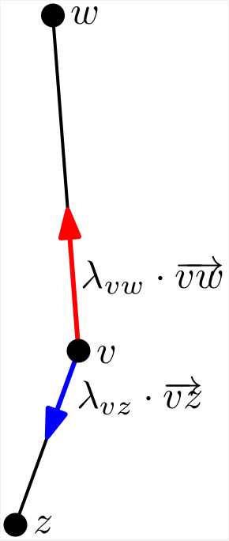
First idea: Far away neighbors
Can an internal vertex $v$ of $G$, say with $y\left(v\right)=0$, have a ʽʽvery highʼʼ neighbor $w$ in $Γ$?
If and only if it has a ʽʽvery lowʼʼ neighbor $z$!
Indeed, from $y\left(v\right)=\sum_{u∈𝒩\left(v\right)}{\left(λ_{vu}∙y\left(u\right)\right)=0}$, we get that the sum $\sum_{u∈𝒩\left(v\right)}{(λ_{vu}∙y\left(u\right))}$ has large positive contribution $λ_{vw}∙y\left(w\right)$, which has hence to be ʽʽbalancedʼʼ by a large negative contribution.

Slide 11
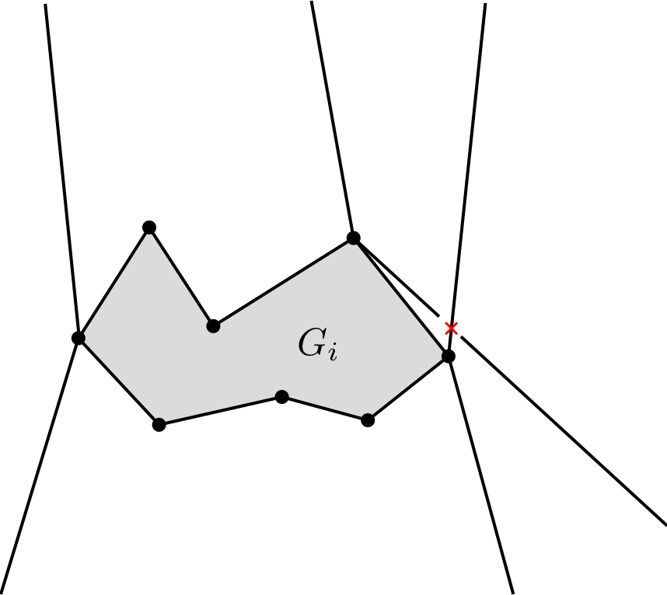
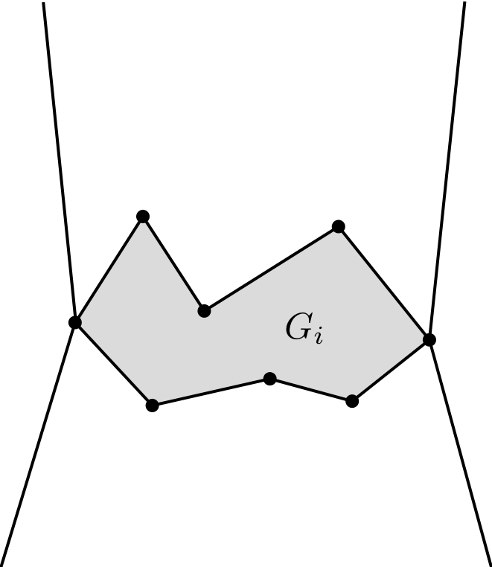
Second idea: Biconnectivity helps
Consider a biconnected subgraph $G_{i}$ of $G$. How many vertices of $G_{i}$ can have neighbors in $G$ ʽʽmuch higherʼʼ than $G_{i}$ in $Γ$?
At most two!

Slide 12
The $y$-extent of $Γ$ is at most $δ∙{\left(\frac{3}{λ}\right)}^{n}$
Define a sequence $G_{1},…,$ $G_{k}$ of induced subgraphs of $G$ satisfying the following properties (let $Γ_{i}$be the restriction of $Γ$to $G_{i}$):
the graph $G_{i}$ is biconnected and has at least $i+3$ vertices;
every vertex of $V(G)\backslash V(G_{i})$ lies in the outer face of $Γ_{i}$; and
the $y$-extent of $Γ_{i}$ is at most $δ∙{\left(\frac{3}{λ}\right)}^{i}$.

Slide 13
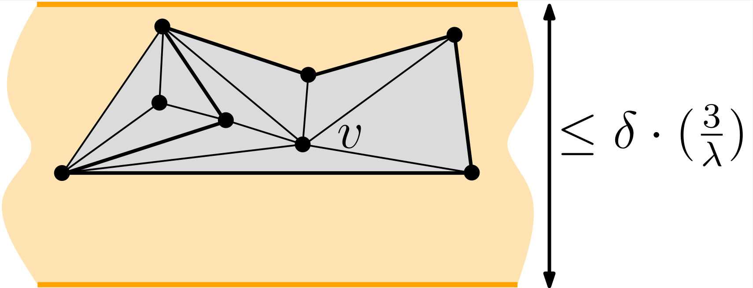
Base case
Let $v$ be the internal vertex defining the smallest height $δ$ in a face $f$ (assume such a height is vertical).
Then $v$ has no neighbors far below it.
Hence $v$ has no neighbors far above it.
$G_{1}$:

Slide 14
Inductive case
Assume that $G_{i}$ has been defined for some $i≥1$ and that $G_{i}≠G$ (as otherwise we are done). We define $G_{i+1}$.

Slide 15
Inductive case
Since $G_{i}$ is biconnected and has at least $i+3≥4$ vertices, the cycle bounding the outer face of $G_{i}$ has at least $3$ vertices.

Slide 16
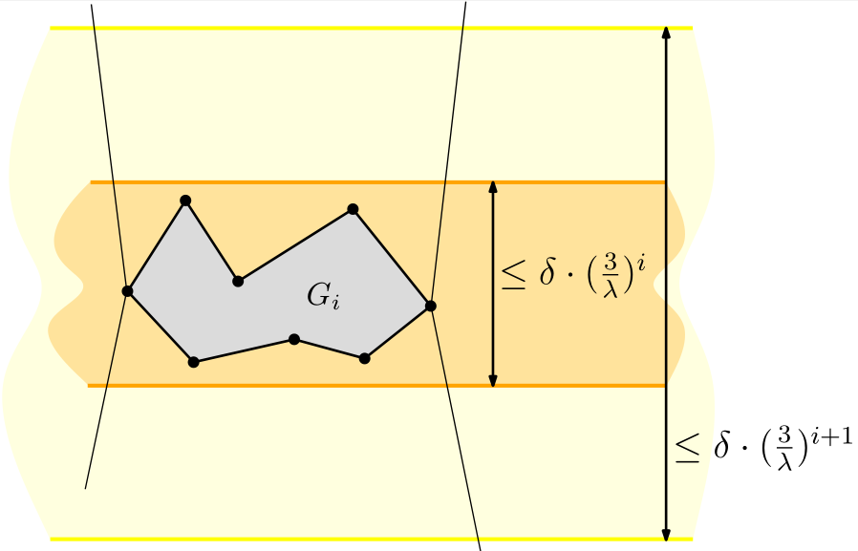
Inductive case
Out of these (at least) $3$ vertices at most $2$ have neighbors in $G$ that are ʽʽvery highʼʼ or ʽʽvery lowʼʼ.

Slide 17
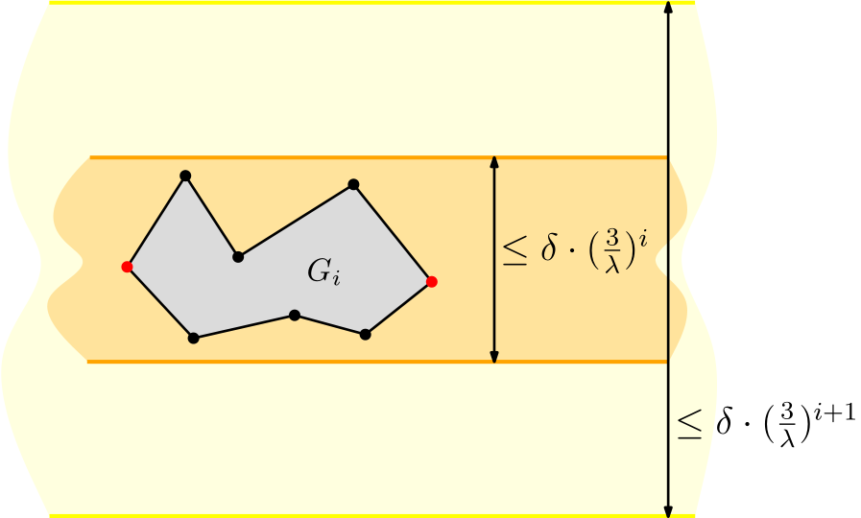
Inductive case
Out of these (at least) $3$ vertices at most $2$ have neighbors in $G$ that are ʽʽvery highʼʼ or ʽʽvery lowʼʼ.

Slide 18
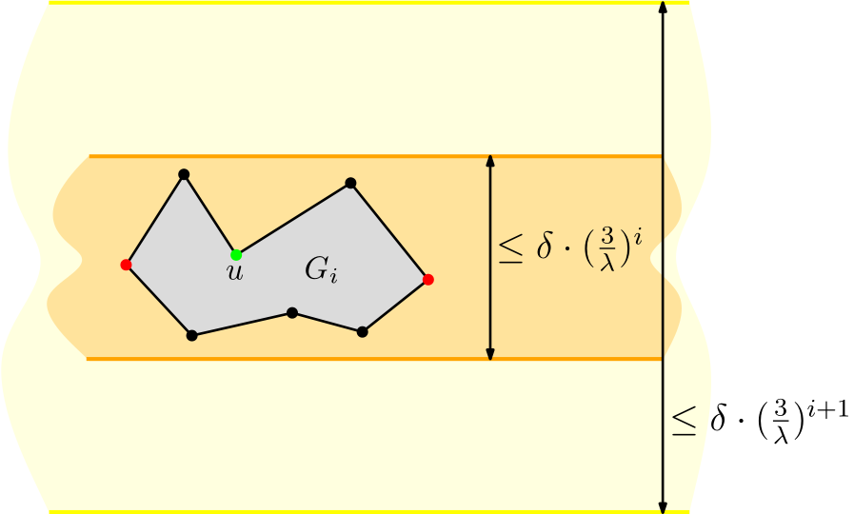
Inductive case
Consider any internal vertex $u$ of $G$ that is on the boundary of $G_{i}$ and that does not have neighbors very high or very low.

Slide 19
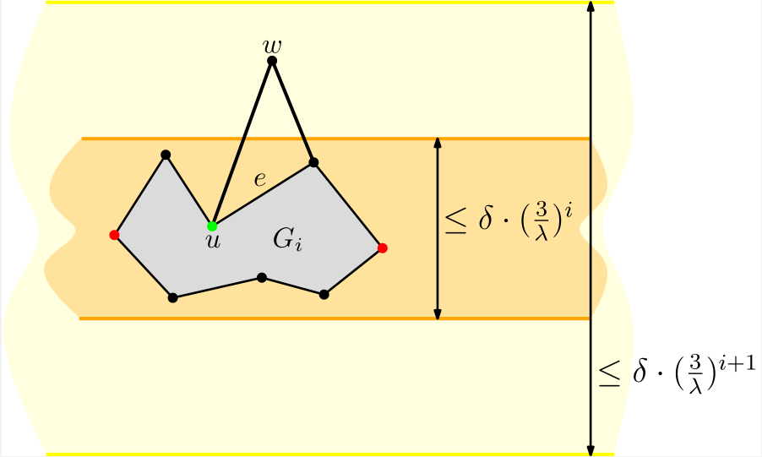
Inductive case
Consider any edge $e$incident to $u$ on the boundary of $G_{i}$ and let $w$ be the third vertex of the triangular face incident to $e$ outside $G_{i}$.

Slide 20
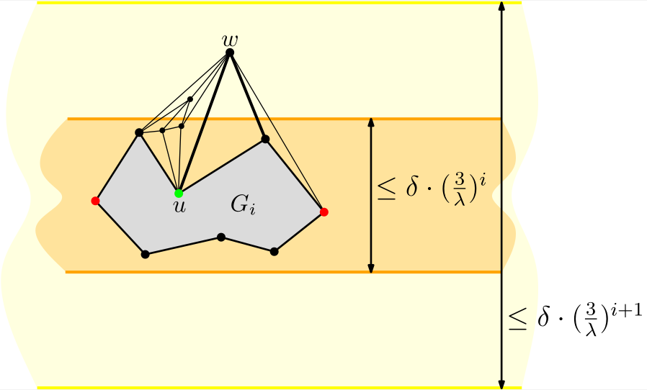
Inductive case
Define $G_{i+1}$ by adding to $G_{i}$ the vertex $w$, the edges from $w$ to $G_{i}$ as well as the subgraph of $G$ inside the resulting faces.

Slide 21
The $y$-extent of $Γ$ is at most $δ∙{\left(\frac{3}{λ}\right)}^{n}$
Since $G_{i}$ has at least $i+3$ vertices, for some $i^{∗}≤n−3$, we have that $G_{i^{∗}}$ has $n$vertices, hence $G_{i^{∗}}=G$.
Hence, the $y$-extent of $Γ_{i^{∗}}=Γ$ is at most $δ∙{\left(\frac{3}{λ}\right)}^{i^{∗}}<δ∙{\left(\frac{3}{λ}\right)}^{n}$.
Theorem 1: The resolution of a Floater drawing $Γ$of an $n$-vertex maximal plane graph is larger than or equal to $r_{Δ}∙λ^{O(n)}$, where:
$r_{Δ}$ is the resolution of the triangle $Δ$ bounding the outer face of $Γ$
$λ$ is the smallest coefficient $λ_{vu}$, over all pairs of neighbors $(v,u)$.

Slide 22
Morphs
A planar morph between two planar straight-line drawings $Γ^{0}$ and $Γ^{1}$of a plane graph $G$is a continuous family of planar straight-line drawings $\left\{Γ^{t}:t∈[0,1]\right\}$ of $G$.
$$Γ^{0}$$
$$Γ^{0.25}$$
$$Γ^{0.5}$$
$$Γ^{0.75}$$
$$Γ^{1}$$

Slide 23
Floater and Gotsman’s morphing algorithm
Let $G$be a $3$-connected plane graph and let $Γ^{0}$ and $Γ^{1}$ be two convex straight-line drawings of $G$ whose outer faces are bounded by the same polygon $𝒫$.

Slide 24
Floater and Gotsman’s morphing algorithm
Compute coefficients $λ_{vu}^{0}$ such that the Floater drawing with those coefficients is $Γ^{0}$. Compute coefficients $λ_{vu}^{1}$ such that the Floater drawing with those coefficients is $Γ^{1}$.
For every $t∈[0,1]$, define $λ_{vu}^{t}={(1−t)∙λ}_{vu}^{0}+{t∙λ}_{vu}^{1}$ and let $Γ^{t}$ be the Floater drawing with coefficients $λ_{vu}^{t}$. Then $\left\{Γ^{t}:t∈[0,1]\right\}$ is a (convex) planar morph between $Γ^{0}$ and $Γ^{1}$.

Slide 25
Our original motivation
Does an algorithm exist to construct a planar morph between any two planar straight-line drawings of the same plane graph with polynomially-bounded resolution?
Yes, for trees [Barrera-Cruz, Borrazzo, Da Lozzo, Di Battista, Frati, Patrignani, and Roselli, WADS 2019]
Yes, for ʽʽgeneralized Schnyder drawingsʼʼ [Barrera-Cruz, Haxell, and Lubiw, DCG 2019]
We wanted to understand whether Floater and Gotsman’s algorithm gives us a positive answer to the above question…

Slide 26
Theorem 2: Let $G$be a maximal plane graph and let $Γ^{0}$ and $Γ^{1}$ be two planar straight-line drawings of $G$ whose outer faces are bounded by the same triangle $Δ$.
There exists a Floater-Gotsman morph $\left\{Γ^{t}:t∈[0,1]\right\}$between $Γ^{0}$ and $Γ^{1}$such that, for each $t∈\left[0,1\right]$, the resolution of $Γ^{t}$ is larger than or equal to ${\left(r/n\right)}^{O(n)}$, where $r$ is the minimum between the resolution of $Γ^{0}$ and $Γ^{1}$.

Slide 27
Theorem 3: For every $n≥6$ multiple of $3$, there exist an $n$-vertex maximal plane graph $G$ and two planar straight-line drawings $Γ^{0}$ and $Γ^{1}$ of $G$ such that:
the outer faces of $Γ^{0}$ and $Γ^{1}$ are delimited by the same triangle $Δ$;
the resolution of both $Γ^{0}$ and $Γ^{1}$ is larger than or equal to $\frac{c}{n^{2}}$, for some constant $c$; and
any Floater-Gotsman morph between $Γ^{0}$ and $Γ^{1}$ contains a drawing whose resolution is smaller than or equal to $\frac{1}{2^{Ω\left(n\right)}}$.

Slide 28
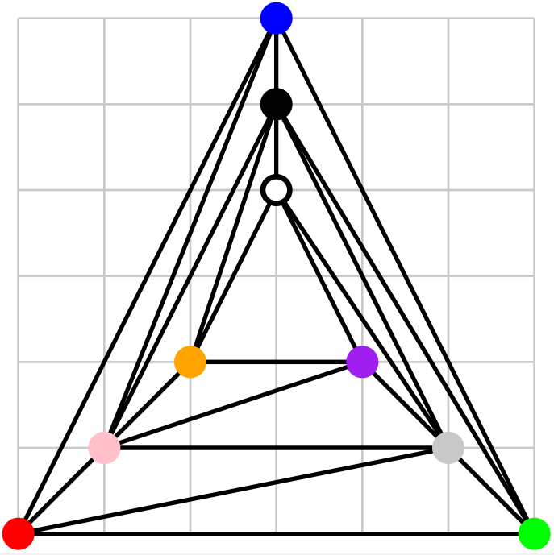
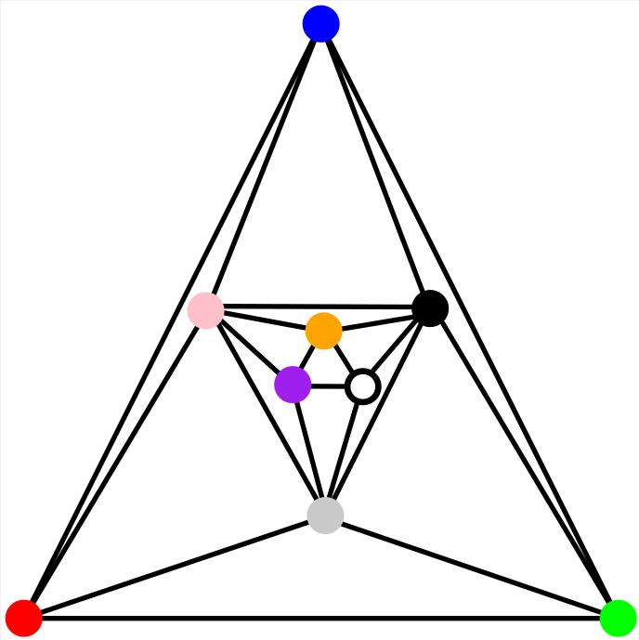
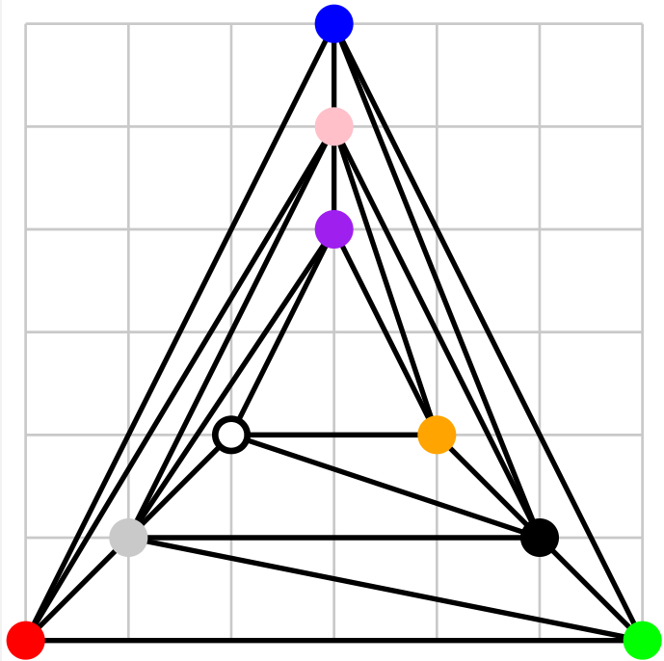
Proof idea:
$$Γ^{0}$$
$$Γ^{0.5}$$
$$Γ^{1}$$

Slide 29
Conclusions and open problems
OPEN 1: Extend to $3$-connected plane graphs our lower bounds for maximal plane graphs.
OPEN 2: When applied to Tutte drawings, our tight bound $r_{Δ}∙λ^{θ(n)}$ on the resolution $r$of Floater drawings of maximal plane graphs becomes $r_{Δ}∙{1/2}^{O\left(n ∙\log{n}\right)}≤r≤ r_{Δ}∙{1/2}^{Ω\left(n\right)}$. What’s the right bound?
OPEN 3: The lower and upper bounds on the resolution of Floater-Gotsman morphs are ${\left(r/n\right)}^{O(n)}$ and $\frac{1}{2^{Ω\left(n\right)}}$. What’s the right bound? Is the dependency on $r$ in the exponential function needed?

Slide 30
Thanks for your attention!

